Slide 1
Capital Budgeting: Nature and type of Investment decision, Net Present value (NPV), Internal Rate of Return (IRR), Payback period, Profitability Index, Nature and Behavior of Cost. 5 hour

Slide 2
Capital budgeting
Capital refers to the total investment of a company or firm in money, tangible and intangible assets.
Budgeting :- the art of building budgets
Some examples :
Fixed assets, plant and machinery, goodwill etc…
Expenditure related to addition, expansion, improvement and alteration to the fixed assets
The replacement of fixed assets.
Research and development project.

Slide 3
According to Charles T. Hrongreen, “capital budgeting is a long-term planning for making and financing proposed capital outlays.

Slide 4
Need and Importance of Capital Budgeting
1. Long-term implications:
A capital budgeting decision has its effect over a long time span and inevitably affects the company’s future cost structure and growth.
Wrong decision and long-term survival
Lack of investment and competitive position
2. Involvement of large amount of funds:
Need substantial amount of capital outlay
underlines the need for thoughtful, wise and correct decisions

Slide 5
Need and Importance of Capital Budgeting
3. Irreversible decision:
Once the decision is taken for purchasing a permanent asset, it is very difficult to dispose off those assets without involving huge losses
Irreversible because it is difficult to find a market for such assets
4. Risk and uncertainty:
Investment is present and return is future
The future is uncertain and full of risk
Longer the period of project, greater may be the risk and uncertainty

Slide 6
Need and Importance of Capital Budgeting
5. Difficult to make decision
Is a difficult and complicated exercise as it require an over all assessment of future events which are uncertain
Estimation of future benefits and cost correctly in quantitative terms subject to the uncertainties caused by economic-political social and technological factors
6. Permanent commitment of funds
7. Maximize the worth of Equity Shareholders

Slide 7
Capital budgeting process
Fixing property
Final approval
Implementation
Evaluation of proposals
Identification of various investments
Screening the available resources
Independent
Contingent
Mutually exclusive

Slide 8
Kinds of capital budgeting decision
Traditional methods
pay-back period methods
post-pay-back methods
accounting rate of return
Modern methods
NPV
IRR
PI Methods

Slide 9
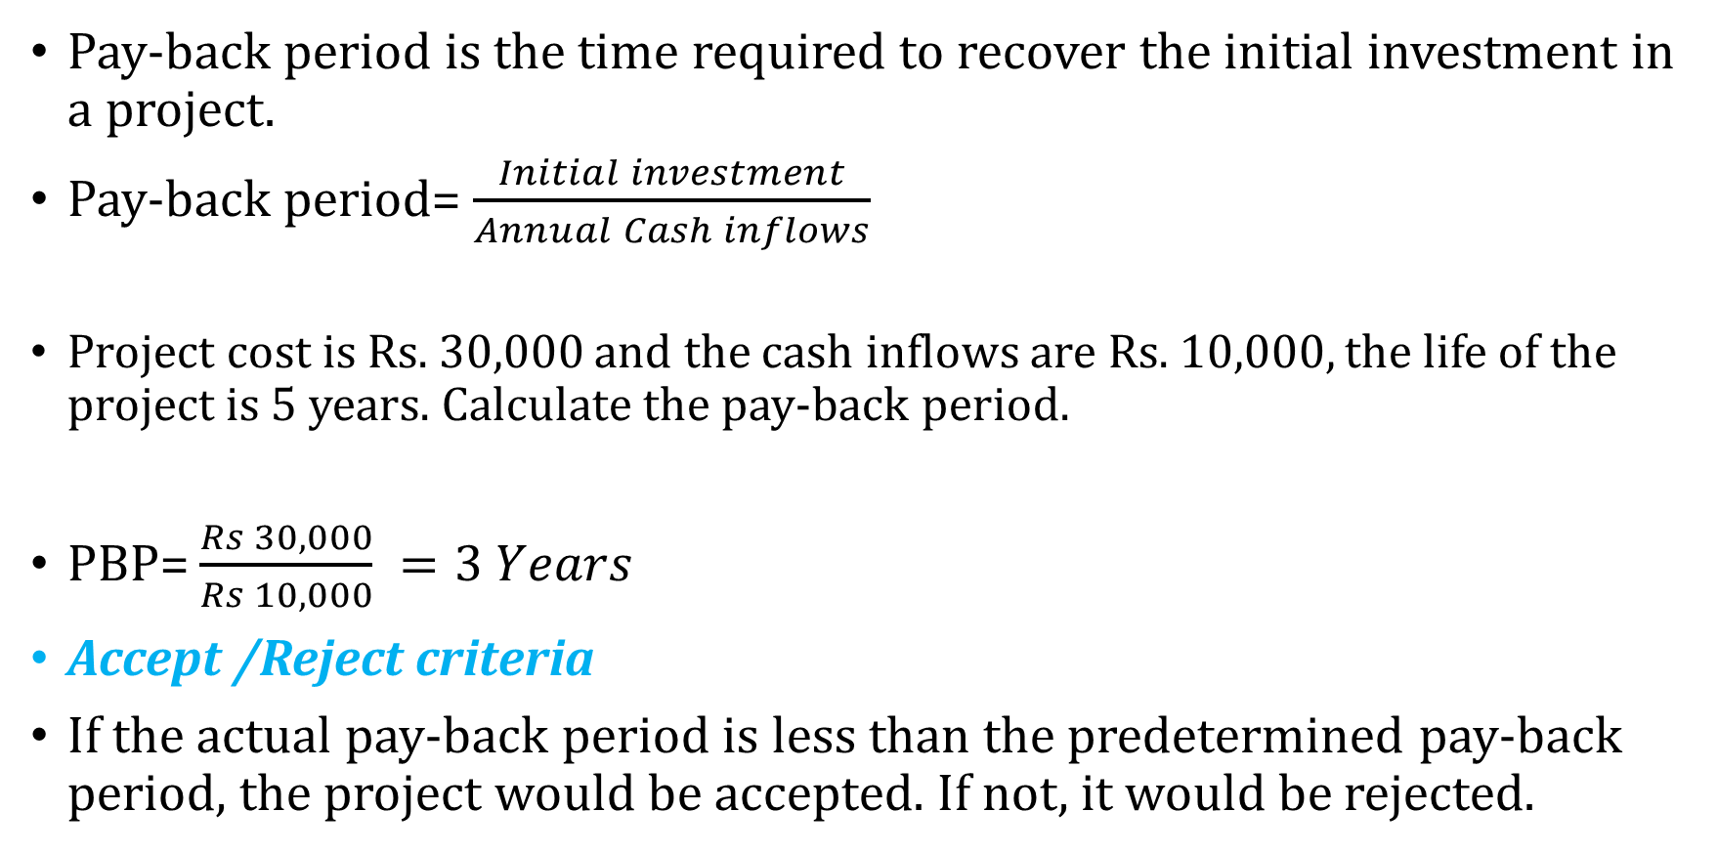
Pay-back period
Pay-back period is the time required to recover the initial investment in a project.
Pay-back period= $\frac{Initial investment}{Annual Cash inflows}$
Project cost is Rs. 30,000 and the cash inflows are Rs. 10,000, the life of the project is 5 years. Calculate the pay-back period.
PBP= $\frac{Rs 30,000}{Rs 10,000} =3 Years$
Accept /Reject criteria
If the actual pay-back period is less than the predetermined pay-back period, the project would be accepted. If not, it would be rejected.

Slide 10
One projects require an initial cash outflow of Rs. 25,000. The cash inflows for 6 years are Rs. 5,000, Rs. 8,000, Rs. 10,000, Rs. 12,000, Rs. 7,000 and Rs. 3,000.
Pay-back period= 3 years + 2000/12000 x 12 months
= 3 years 2 months

Slide 11
Limitation:
It does not consider the cash inflows earned after pay-back period
Considers the receivable after the pay-back period
Exercise:
1. from the following particulars compute: a) pay-back period, post pay-back profitability , and c) post pay-back profitability index
Cash outflow: RS 100,000
Annual cash inflow: Rs 25,000
Estimated life: 6 years

Slide 12
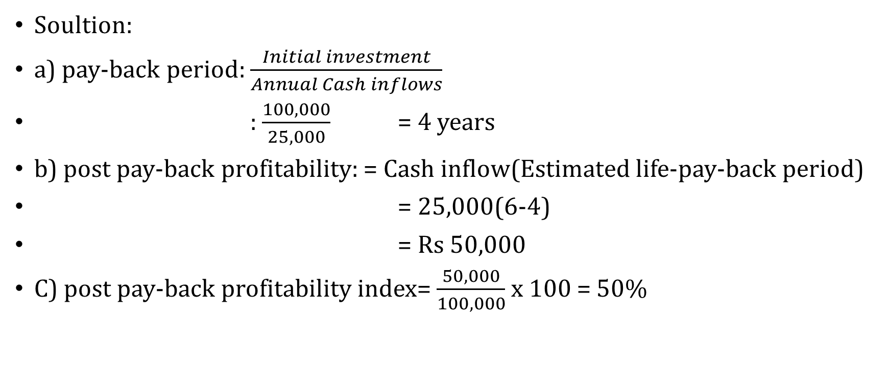
Soultion:
a) pay-back period: $\frac{Initial investment}{Annual Cash inflows}$
: $\frac{100,000}{25,000}$ = 4 years
b) post pay-back profitability: = Cash inflow(Estimated life-pay-back period)
= 25,000(6-4)
= Rs 50,000
C) post pay-back profitability index= $\frac{50,000}{100,000}$ x 100 = 50%

Slide 13
Accounting rate of return(ARR)
Average rate of return is being considered for project evaluation
Merits:
1. It is easy to calculate and simple to understand. 2. It is based on the accounting information rather than cash inflow. 3. It is not based on the time value of money. 4. It considers the total benefits associated with the project.
Demerits:
1.It ignores the time value of money. 2. It ignores the reinvestment potential of a project. 3. Different methods are used for accounting profit. So, it leads to some difficulties in the calculation of the project.

Slide 14
Method:
ARR= Average annual profit/average investment
Average annual profit = total profit over investment period/Number of years
Average Investment= (Book value at year 1+ Book value at the end of useful life)/2
Criteria to accept or reject:
If the actual accounting rate of return is more than the predetermined required rate of return, the project would be accepted. If not it would be rejected.

Slide 15
XYZ Company is looking to invest in some new machinery to replace its current malfunctioning one. The new machine, which costs ₹420,000, would generate annual revenue by ₹ 200,000 and annual expenses by ₹ 50,000. The machine is estimated to have a useful life of 12 years and zero salvage value.

Slide 16
Average annual profit:
Total revenue = 200,000 x 12 = 2,400,000
Annual expenses = 50,000 x 12 = 600,000
Depreciation = 420,000
Total profit = 1,380,000
Average profit = TP/12 = 115,000
Average investment = (420,000+0)/2 =210,000
ARR = ₹115,000/ ₹210,000 = .5476
= 54.67%

Slide 17
Average Investment= (Initial cost + Installation expenses- salvage value) / 2 +Additional Net Working Capital + Salvage Value.
If the initial investment of the XYZ ltd. in buying a machine is Rs 1, 21, 000, salvage value is Rs 11,000, working capital is Rs 12000 & life of the machine is 5 years. SLM of depreciation is adopted. Calculate the average investment.

Slide 18
Modern methods

Slide 19
Net Present value method
Cash flows of the investment project should be forecasted based on realistic assumption
Appropriate discount rate (OCC)
PV of cash flows should be calculated using the OCC as discount rate
The project should be accepted if NPV>0

Slide 20

NPV= difference between PVs of COFs and CIFs
NPV= [$\frac{C_{1}}{1+k}+\frac{C_{2}}{{(1+k)}^{2}}+\frac{C_{3}}{{(1+k)}^{3}}+$-----+$\frac{C_{n}}{{(1+k)}^{n}}$ ]- $C_{0}$

Slide 21
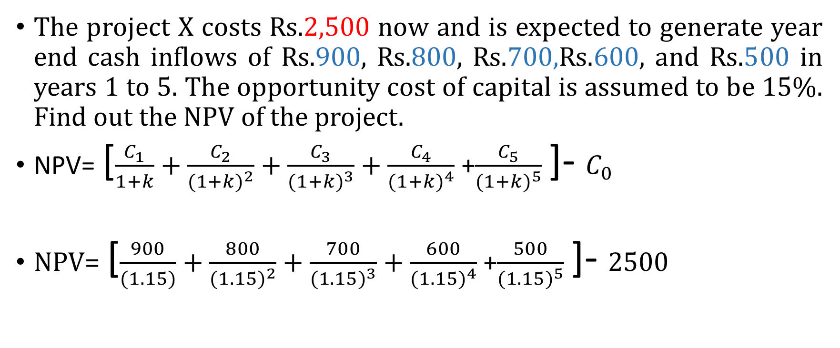
Example
The project X costs Rs.2,500 now and is expected to generate year end cash inflows of Rs.900, Rs.800, Rs.700,Rs.600, and Rs.500 in years 1 to 5. The opportunity cost of capital is assumed to be 15%. Find out the NPV of the project.
NPV= [$\frac{C_{1}}{1+k}+\frac{C_{2}}{{(1+k)}^{2}}+\frac{C_{3}}{{(1+k)}^{3}}+\frac{C_{4}}{{(1+k)}^{4}}$ +$\frac{C_{5}}{{(1+k)}^{5}}$ ]- $C_{0}$
NPV= [$\frac{900}{(1.15)}+\frac{800}{{(1.15)}^{2}}+\frac{700}{{(1.15)}^{3}}+\frac{600}{{(1.15)}^{4}}$ +$\frac{500}{{(1.15)}^{5}}$ ]- $2500$

Slide 22
NPV= ( 782.60 + 605 + 460.2 + 343.1 + 248.59 )-2500
2439.49-2500 = -60.51
The NPV method can be used to select between mutually exclusive projects: the one with highest NPV should be selected.

Slide 23
Evaluation of NPV method
NPV is the most acceptable method:
Time value
Measure of true profitability
Value-additivity
Share holders value
Limitations
Cash flow estimation
Discount rate (non constant and difficult)

Slide 24

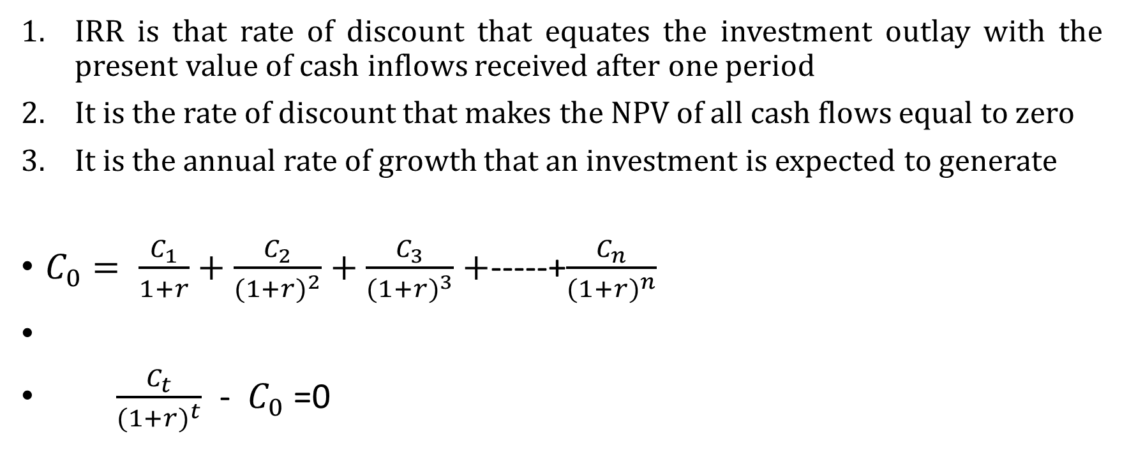
Internal rate of Return (IRR)
IRR is that rate of discount that equates the investment outlay with the present value of cash inflows received after one period
It is the rate of discount that makes the NPV of all cash flows equal to zero
It is the annual rate of growth that an investment is expected to generate
$C_{0}= \frac{C_{1}}{1+r}+\frac{C_{2}}{{(1+r)}^{2}}+\frac{C_{3}}{{(1+r)}^{3}}+$-----+$\frac{C_{n}}{{(1+r)}^{n}}$
$\frac{C_{t}}{{(1+r)}^{t}}$ - $C_{0}$ =0

Slide 25
Calculating IRR by trial and error method
Select any discount rate to compute the present value
If the calculated PV of the expected cash inflow is lower than the PV of cash outflows, a lower rate should be tried
If the calculated PV of the expected cash inflow is higher than the PV of cash outflows, a higher rate should be tried
The process will be repeated until the NPV becomes zero

Slide 26
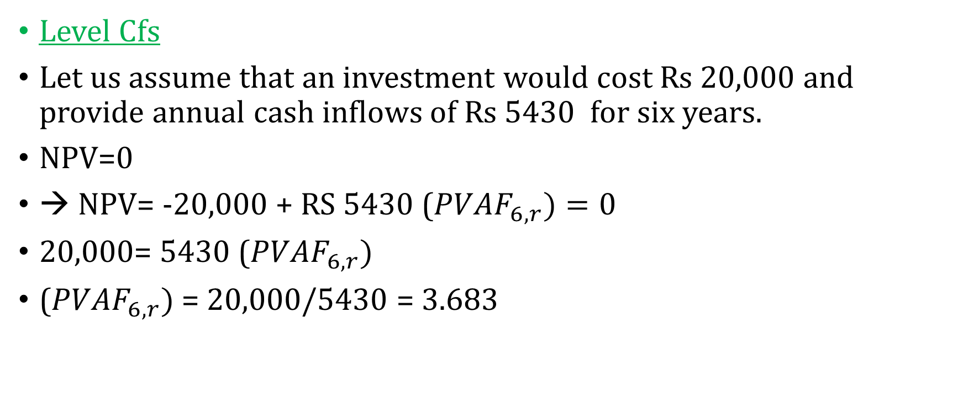
Example 1
Level Cfs
Let us assume that an investment would cost Rs 20,000 and provide annual cash inflows of Rs 5430 for six years.
NPV=0
→ NPV= -20,000 + RS 5430 (${PVAF}_{6,r})=0$
20,000= 5430 (${PVAF}_{6,r})$
(${PVAF}_{6,r})$ = 20,000/5430 = 3.683

Slide 27
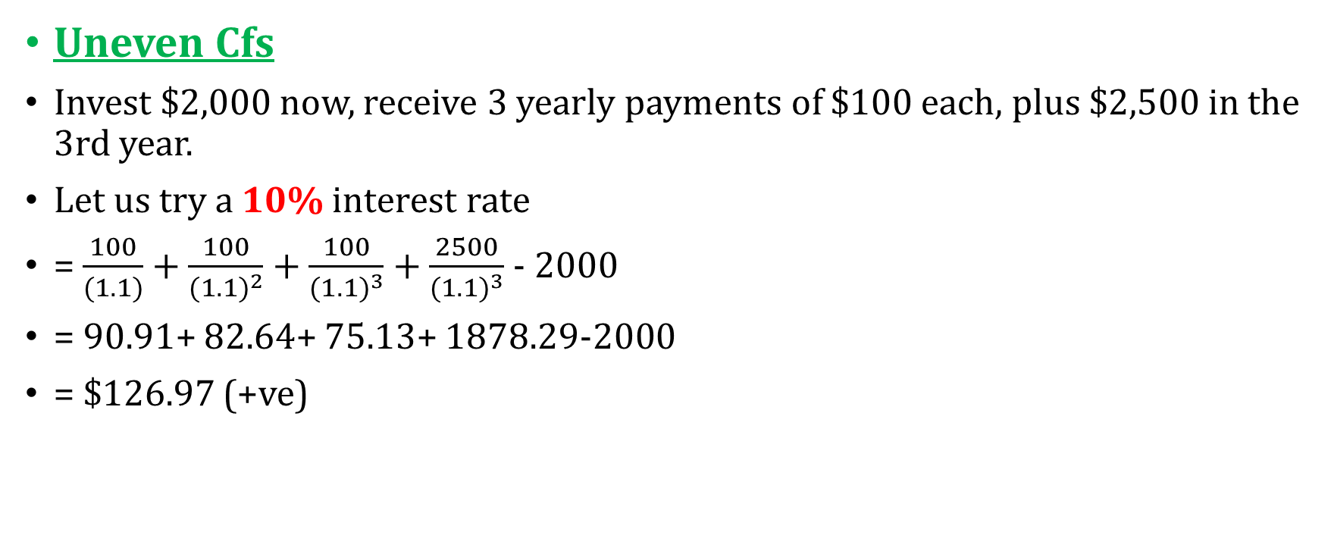
Example 2
Uneven Cfs
Invest $2,000 now, receive 3 yearly payments of $100 each, plus $2,500 in the 3rd year.
Let us try a 10% interest rate
= $\frac{100}{(1.1)}+\frac{100}{{(1.1)}^{2}}+\frac{100}{{(1.1)}^{3}}+\frac{2500}{{(1.1)}^{3}}$ - 2000
= 90.91+ 82.64+ 75.13+ 1878.29-2000
= $126.97 (+ve)

Slide 28
Let’s try 12%
NPV= 89.29+ 79.72+ 71.18+1779.45-2000
= 19.64
Let’s try 12.4%
1760.52+70.42+79.15+88.97-2000= -0.94

Slide 29
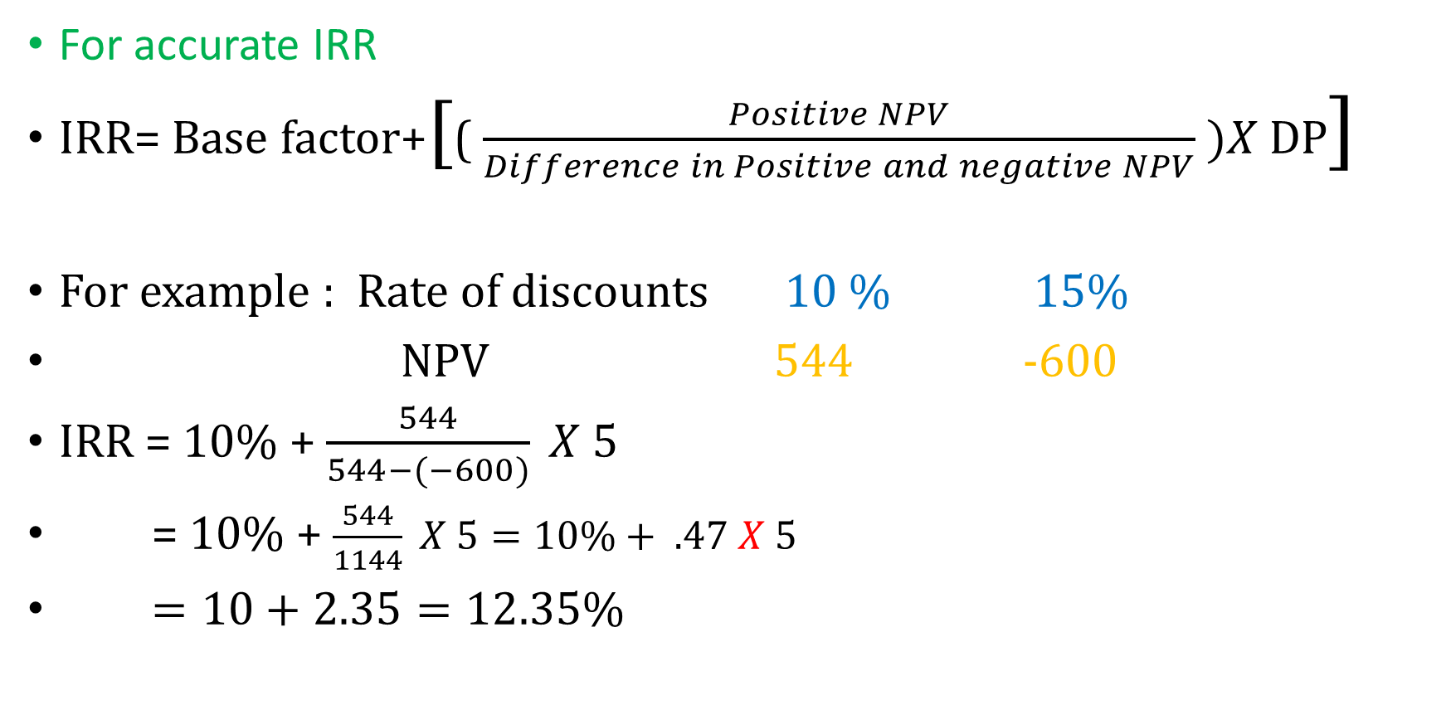
For accurate IRR
IRR= Base factor+[( $\frac{Positive NPV}{Difference in Positive and negative NPV} )X$DP]
For example : Rate of discounts 10 % 15%
NPV 544 -600
IRR = 10% + $\frac{544}{544−(−600)} X 5$
= 10% + $\frac{544}{1144} X 5=10\%+ .47 X 5$
$=10+2.35=12.35\%$

Slide 30
NPV and IRR conflict
Independent project: the conflict does not arise
Mutually exclusive projects:
One project may have higher NPV, but the other may have higher IRR
It may arise due to:
Relative size of the project
Due to the different cash flow distribution

Slide 31
Since NPV is an absolute measure, it will rank a project adding more dollar value higher regardless of the initial investment required
IRR is a relative measure, and it will rank projects offering best investment return higher regardless of the total value added.
In case of NPV IRR conflict, always accept the project with higher NPV

Slide 32
Reason:
It is because IRR inherently assumes that any cash flows can be reinvested at the internal rate of return.
This assumption is problematic because there is no guarantee that equally profitable opportunities will be available as soon as cash flows occur.
NPV does not suffer from such a problematic assumption because it assumes that reinvestment occurs at the cost of capital, which is more realistic and conservative

Slide 33
Conflict: Example (size)
 | Project A | Project B
C0 | 10 million | 1 million
C1 | 10 million | 2 million
C2 | 10 million | 1 million
NPV (10%) | 7.4 Million | 1.6 million
IRR | 61.8% | 141.4%

Slide 34
Conflict: Example ( CF)
 | Project C | Project D
C0 | 10 million | 10 million
C1 | 15 m | 0 m
C2 | 10 m | 30 m
NPV (10%) | 11.9 m | 14.8 m
IRR | 100 % | 73.2

Slide 35
6. Profitability Index
Measures the ratio between the present value of future Cfs and the initial investment.
it allow us to quantify the amount of value created per unit of investment
PI = PV of future CF/ Initial investment
if the PI > 1, the project generates value

Slide 36
 | Project A | Project B
Year 0 | -1,500,000 | -3,000,000
Year 1 | 150,000 | 100,000
Year 2 | 300,000 | 500,000
Year 3 | 500,000 | 1,000,000
Year 4 | 200,000 | 1,500,000
Year 5 | 600,000 | 200,000
Year 6 | 500,000 | 500,000
Year 7 | 100,000 | 1,000,000
Discount rate | 10% | 13%

Slide 37
 | Project A | PV | Project B
Year 0 | -1,500,000 |  | -3,000,000
Year 1 | 150,000 | 136,363.64 | 100,000 | 88,495.58
Year 2 | 300,000 | 247,933.88 | 500,000 | 391,573.34
Year 3 | 500,000 | 375,657.40 | 1,000,000 | 693,050.16
Year 4 | 200,000 | 136,602.69 | 1,500,000 | 919,978.09
Year 5 | 600,000 | 372,552.79 | 200,000 | 108,551.99
Year 6 | 500,000 | 282,236.97 | 500,000 | 240,159.26
Year 7 | 100,000 | 51,315.81 | 1,000,000 | 425,060.64
Discount rate | 10% |  | 13%
 | PV | 1,602,663.18 |  | 2,866,869.07
PI |  | 1.0684 |  | 0.96

Slide 38
Cost Concepts

Slide 39
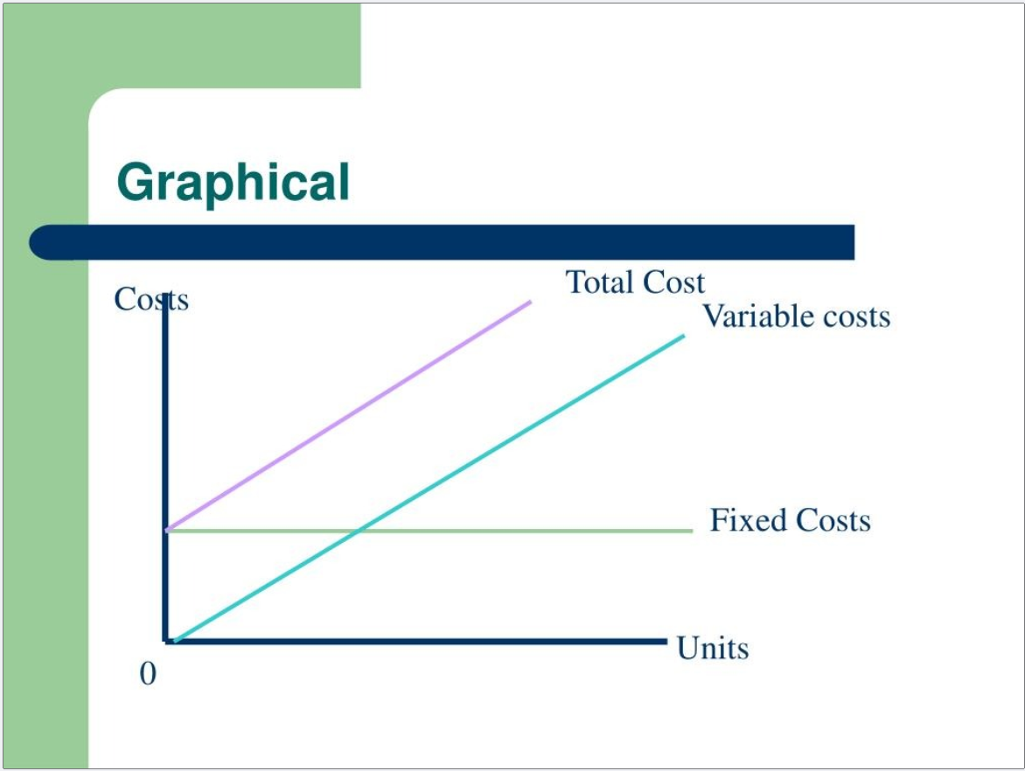

Slide 40
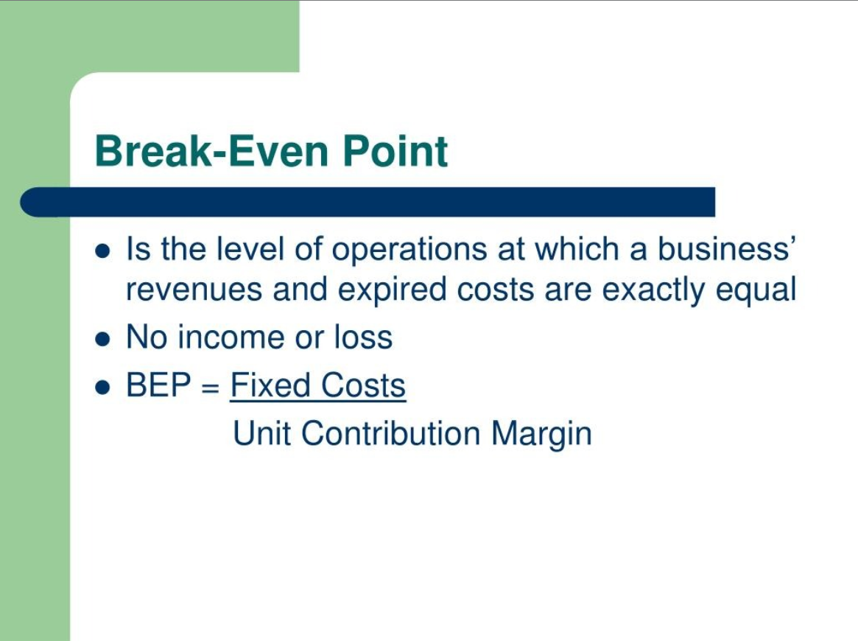

Slide 41
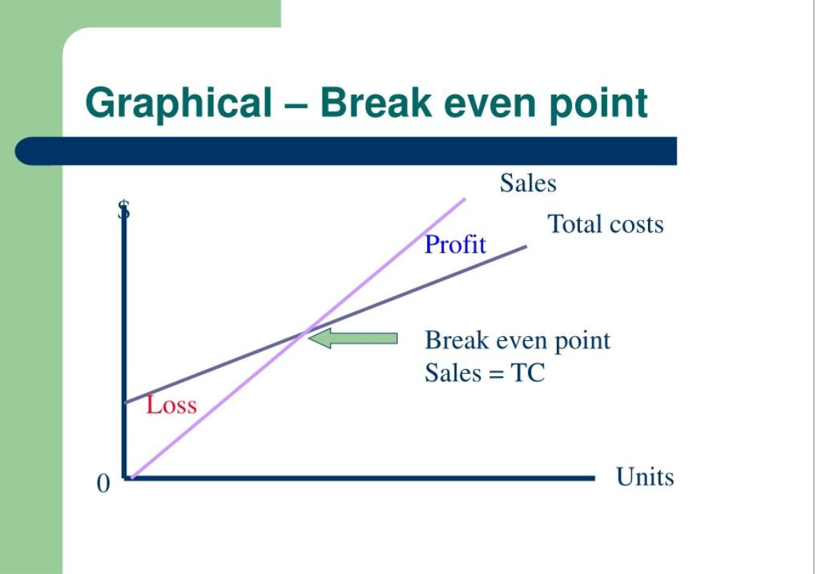

Slide 42
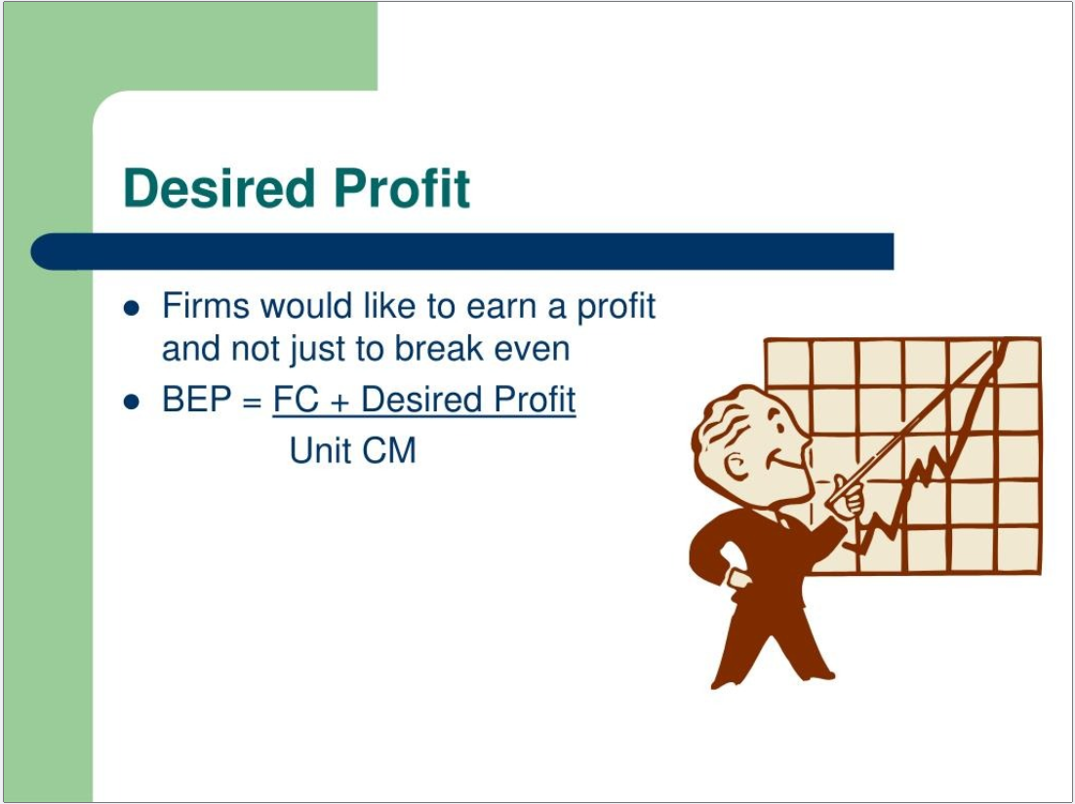

Slide 43
Example: 1
A company has sales of $ 1,000,000, variable cost of $800,000.
Contribution margin= Sales-VC = $1,000,000 - $800,000
= $200,000
Contribution margin ratio = (Sales-VC)/ Sales = 20 %

Slide 44
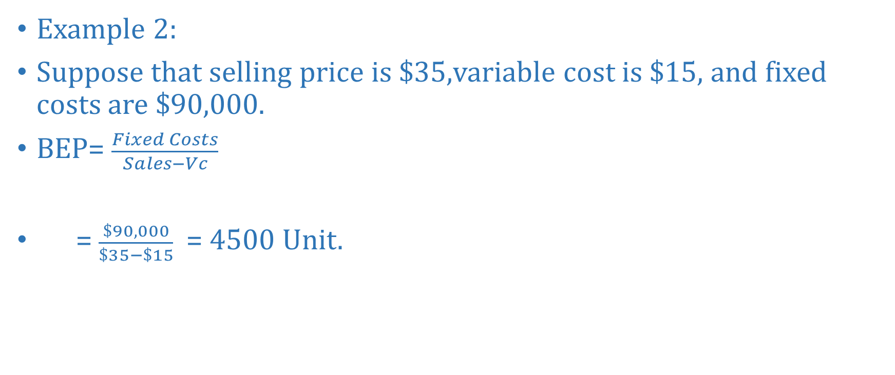
Example 2:
Suppose that selling price is $35,variable cost is $15, and fixed costs are $90,000.
BEP= $\frac{Fixed Costs}{Sales−Vc}$
= $\frac{\$90,000}{\$35−\$15}$ = 4500 Unit.

